Slide 1
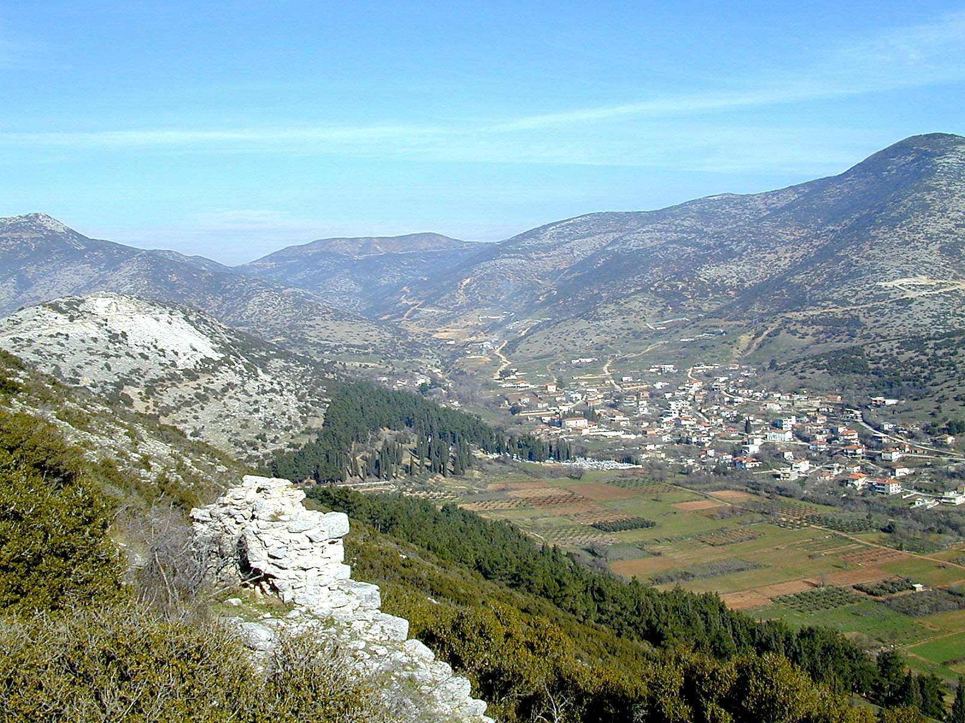
Philippians 2.5-8
Valley east of Philippi; image ©2012 Todd Bolen / BiblePlaces.com

Slide 2
1. Slaves of Christ are writing to Saints in Christ [1.1-2]
2a. Paul is thankful they have partnered in the gospel mission [1.3-8]
2b. Paul prays they will discern it is right to pursue the gospel mission [1.9-11]
3a. Paul’s imprisonment helped the gospel mission [1.12-18a]
3b. Paul’s suffering is not shameful, it exalts Christ [1.18b-26]
4a. Believers will suffer and sacrifice for the gospel as Paul has [1.27-2.4]

Slide 3
Philippians 2.5-8 NIV: In your relationships with one another, have the same mindset as Christ Jesus: Who, being in very nature God, did not consider equality with God something to be used to his own advantage; rather, he made himself nothing by taking the very nature of a servant, being made in human likeness. And being found in appearance as a man, he humbled himself by becoming obedient to death-- even death on a cross!

Slide 4
Philippians 2.5-8 NIV: In your relationships with one another, have the same mindset as Christ Jesus: Who, being in very nature God, did not consider equality with God something to be used to his own advantage; rather, he made himself nothing by taking the very nature of a servant, being made in human likeness. And being found in appearance as a man, he humbled himself by becoming obedient to death-- even death on a cross!
Christ is the eternal and divine Son of God

Slide 5
Philippians 2.5-8 NIV: In your relationships with one another, have the same mindset as Christ Jesus: Who, being in very nature God, did not consider equality with God something to be used to his own advantage; rather, he made himself nothing by taking the very nature of a servant, being made in human likeness. And being found in appearance as a man, he humbled himself by becoming obedient to death-- even death on a cross!
Christ is the Son of God, not God the Father

Slide 6
Philippians 2.5-8 NIV: In your relationships with one another, have the same mindset as Christ Jesus: Who, being in very nature God, did not consider equality with God something to be used to his own advantage; rather, he made himself nothing by taking the very nature of a servant, being made in human likeness. And being found in appearance as a man, he humbled himself by becoming obedient to death-- even death on a cross!
Christ had equality with God the Father

Slide 7
Philippians 2.5-8 NIV: In your relationships with one another, have the same mindset as Christ Jesus: Who, being in very nature God, did not consider equality with God something to be used to his own advantage; rather, he made himself nothing by taking the very nature of a servant, being made in human likeness. And being found in appearance as a man, he humbled himself by becoming obedient to death-- even death on a cross!
Christ did not use equality for his own advantage

Slide 8
Philippians 2.5-8 NIV: In your relationships with one another, have the same mindset as Christ Jesus: Who, being in very nature God, did not consider equality with God something to be used to his own advantage; rather, he made himself nothing by taking the very nature of a servant, being made in human likeness. And being found in appearance as a man, he humbled himself by becoming obedient to death-- even death on a cross!
Christ took on human nature as the man Jesus

Slide 9
Philippians 2.5-8 NIV: In your relationships with one another, have the same mindset as Christ Jesus: Who, being in very nature God, did not consider equality with God something to be used to his own advantage; rather, he made himself nothing by taking the very nature of a servant, being made in human likeness. And being found in appearance as a man, he humbled himself by becoming obedient to death-- even death on a cross!
δοῦλος = slave Christ acted with humility

Slide 10
Philippians 2.5-8 NIV: … rather, he made himself nothing by taking the very nature of a servant, being made in human likeness. And being found in appearance as a man, he humbled himself by becoming obedient to death-- even death on a cross!
Isaiah 52.13-53.12 = the “Servant of Yahweh” passage
Isaiah 53.5 NIV: …he was pierced for our transgressions, he was crushed for our iniquities; the punishment that brought us peace was on him, and by his wounds we are healed.

Slide 11
Philippians 2.5-8 NIV: In your relationships with one another, have the same mindset as Christ Jesus: Who, being in very nature God, did not consider equality with God something to be used to his own advantage; rather, he made himself nothing by taking the very nature of a servant, being made in human likeness. And being found in appearance as a man, he humbled himself by becoming obedient to death-- even death on a cross!
God
Israel
King
Nations

Slide 12
A. Christ always existed as the divine Son of God
B. Christ is the Son of God, distinct from the Father
C. Christ, the Son of God, is equal with the Father
D. Christ did not use equality for his own advantage
E. Christ took on the nature of humanity
F. Christ acted in humility [creature/slave]
G. Christ’s humble obedience took him to the cross

Slide 13
1.27-2.4: Believers should expect to sacrifice and suffer for the sake of the gospel mission.
2.5-8: Christ is the ultimate example of sacrifice and suffering for the sake of the gospel mission. We are to have the same mindset as Christ.

Slide 14
2.2: Seek unity in the church, having the same mindset as each other.
2.5: We all should have the same mindset as Christ.
2.3-4: Be humble enough to sacrifice for each other.
2.5-8: Christ is our example, humbly sacrificing for us.

Slide 15
1.21: Paul was a slave who lived for Christ.
2.5-8: Jesus became a slave to multiply disciples who would live for him.
2.3: We should be humble, not selfishly ambitious or vain.
2.5-8: Christ is our example, filled with true glory but humbly sacrificing for us.

Slide 16
2.3: We should not be selfishly ambitious or vain, rather humbly valuing others and caring for them.
2.5-8: Christ is our example, not living for his own advantage, but humbly sacrificing and suffering to help others through the gospel mission.

Slide 17
1.27: Live worthy of the gospel, live up to the righteousness you have been given in salvation.
2.5-8: Christ is our example, humbly obeying God as his slave, to fulfill his plans for the gospel mission.

Slide 18
Jesus has the character of God and is human as God designed us to be. He is our example.
His absolute purity results in absolute humility.

